Slide 1

The State of Children in Bexar County
Laura McKieran, DrPH
Director, Community Information Now (CI:Now)
October 17, 2016
Credits:
Clarissa Ozuna, PhD(c)
Norma Garza, DrPH(c)
Courtney Denton, MPH

Slide 2

Local data intermediary: collect, analyze, communicate data for the use of people working on community change
Neutral, accurate, timely, understandable
Focus on Bexar and 11 surrounding counties; all issue areas
What we do:
  Help people figure out what to measure and how often
  Find/collect data - some publicly available, some not
  Integrate different service providers’ datasets
  Clean and analyze the data
  Visualize it – maps, charts, etc.
  Online “dashboards” to share progress
  Help people understand and use the data

Slide 3
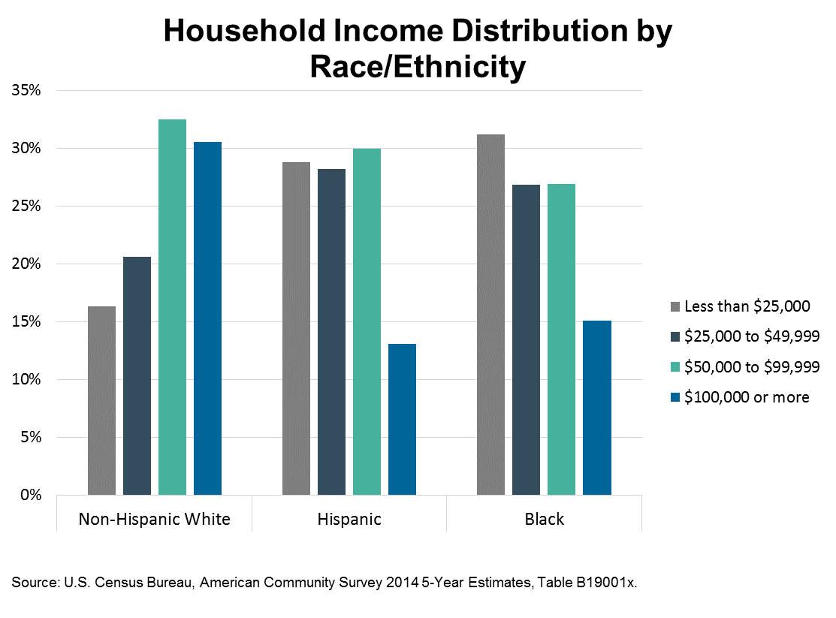
Why look at neighborhood?
Understand people in the context of the environment they live in
Understand outcomes in relationship to location of resources and risks
More clearly see the association with income, poverty, educational attainment
Hispanic household income more evenly distributed than other groups; somewhat “washes out” differences by race/ethnicity

Slide 4
Who are our kids age birth to 8?

Slide 5
Child characteristics
Close to a quarter-million children age birth to 8
About two-thirds Hispanic, 20% non-Hispanic white, 7% black (overwhelmingly non-Hispanic)
More than eight in 10 live with parent(s); one in 10 with grandparent(s)
Six in 10 families are headed by married couple
Four in 10 headed by single parent; of those, nearly 20% have unmarried partner present

Slide 6
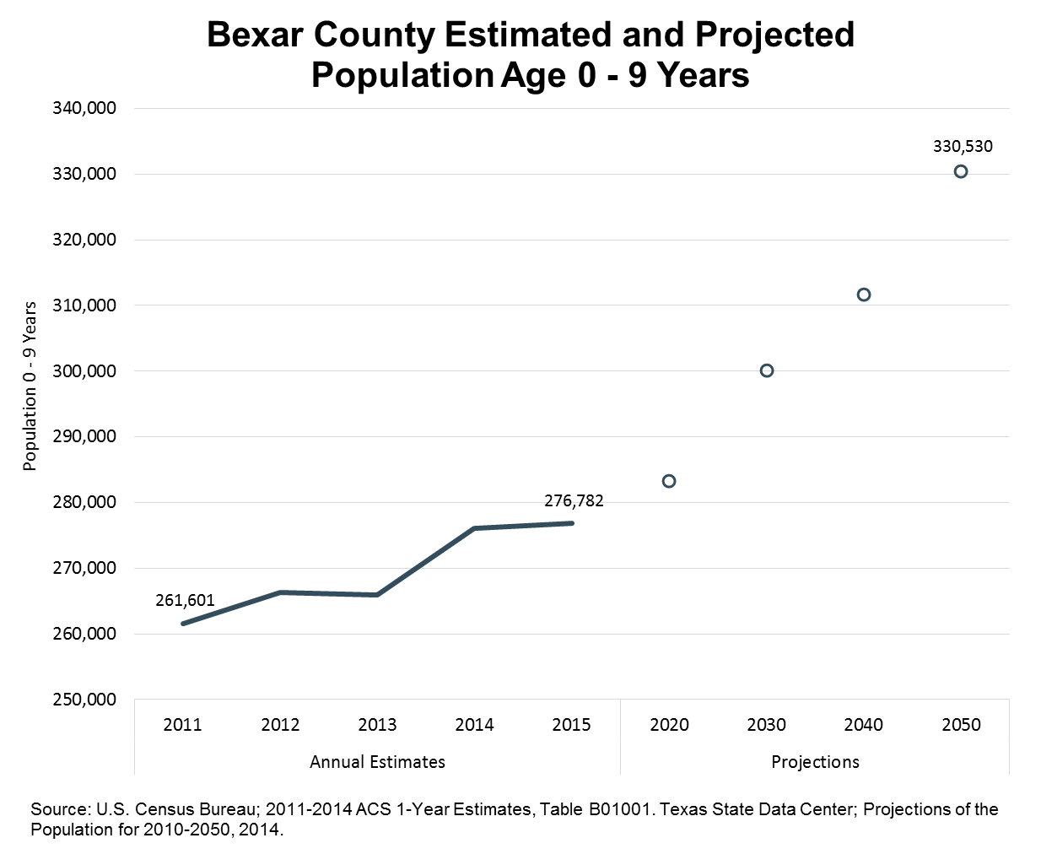
Child population growing
~1.5% average annual growth since 2011
Projected to reach 330,530* by 2050
19% increase over 2015
* Age 0-9 was closest proxy available for age 0-8 projections

Slide 7
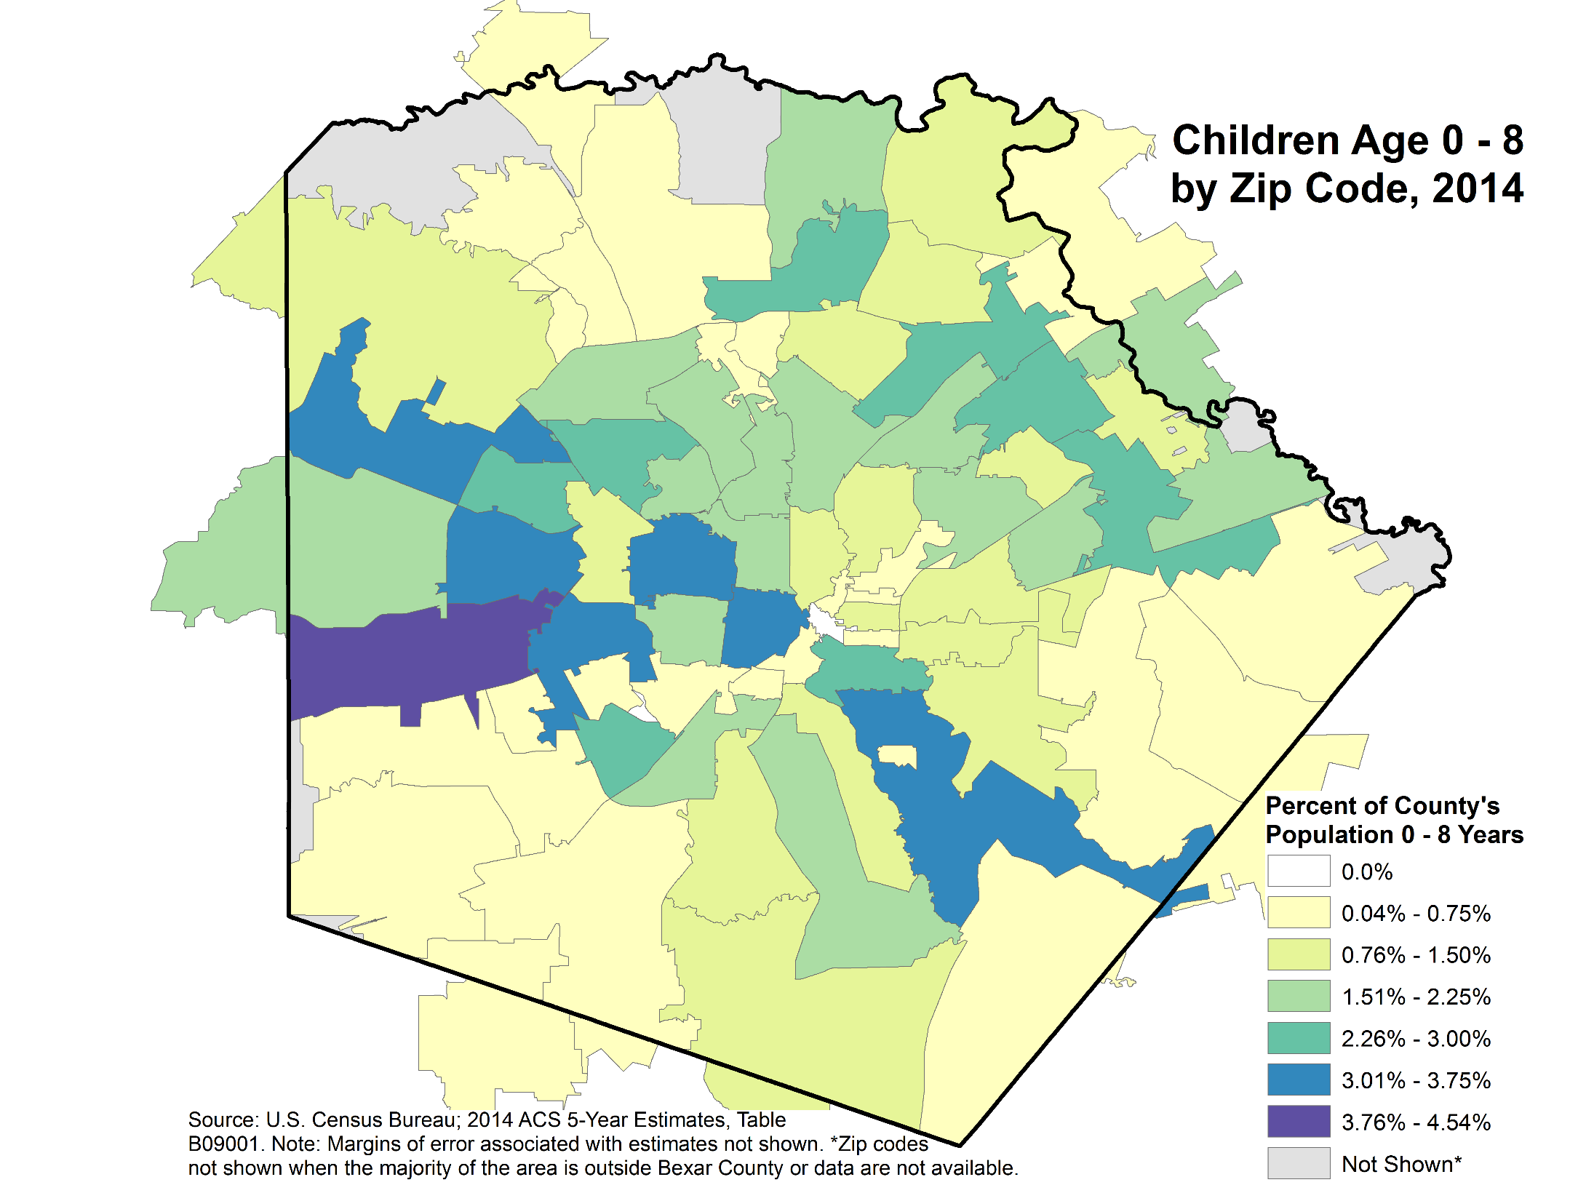
Children not evenly distributed across county
Highest proportion of child pop age 0-8 is on northwest side
High proportions also on near westside, southeast side
Notes:
Distribution of Population 0-8 in Bexar County

Slide 8
What conditions do our kids live in?

Slide 9
Overall poverty trend is slightly down
Federal Poverty Level – in 2016, $24,300 for family of four
Full-time annual income at $7.25/hr is $15,080
County rate is “volatile” – bounces year-to-year
Margins of error mean we can’t be sure there’s any difference between Bexar Co. and Texas, Tarrant Co., or Travis Co.
Slightly lower than Dallas and Harris Co.
great example of statistically significant figure without much practical significance

Slide 10
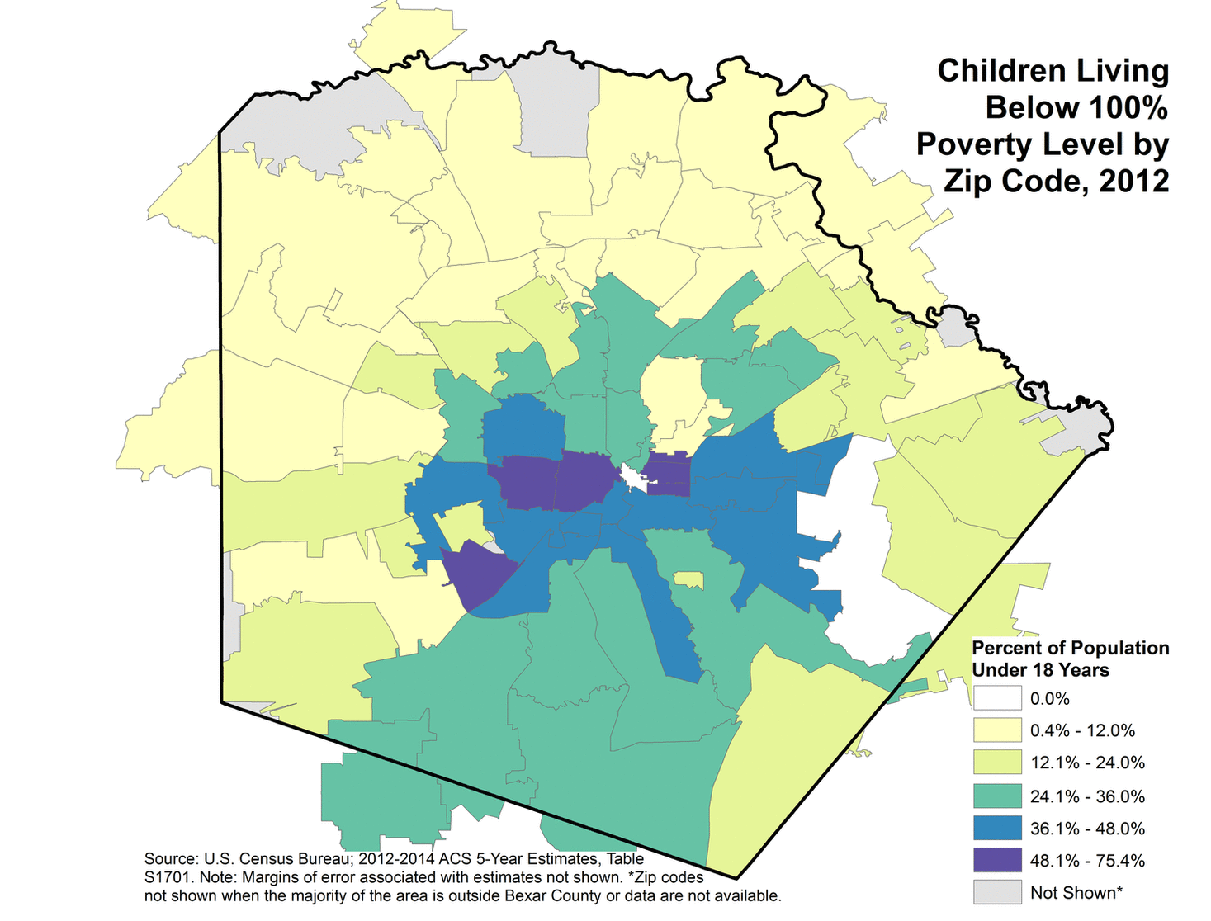
Poverty is concentrated
Highest poverty rate (48% to 75%) is near westside, near eastside, Indian Creek below Kelly AFB
Lowest (below 12.0%) is along and outside 1604 from Hwy 90 northeast to I-35; plus Alamo Heights
Map is animated time series

Slide 11
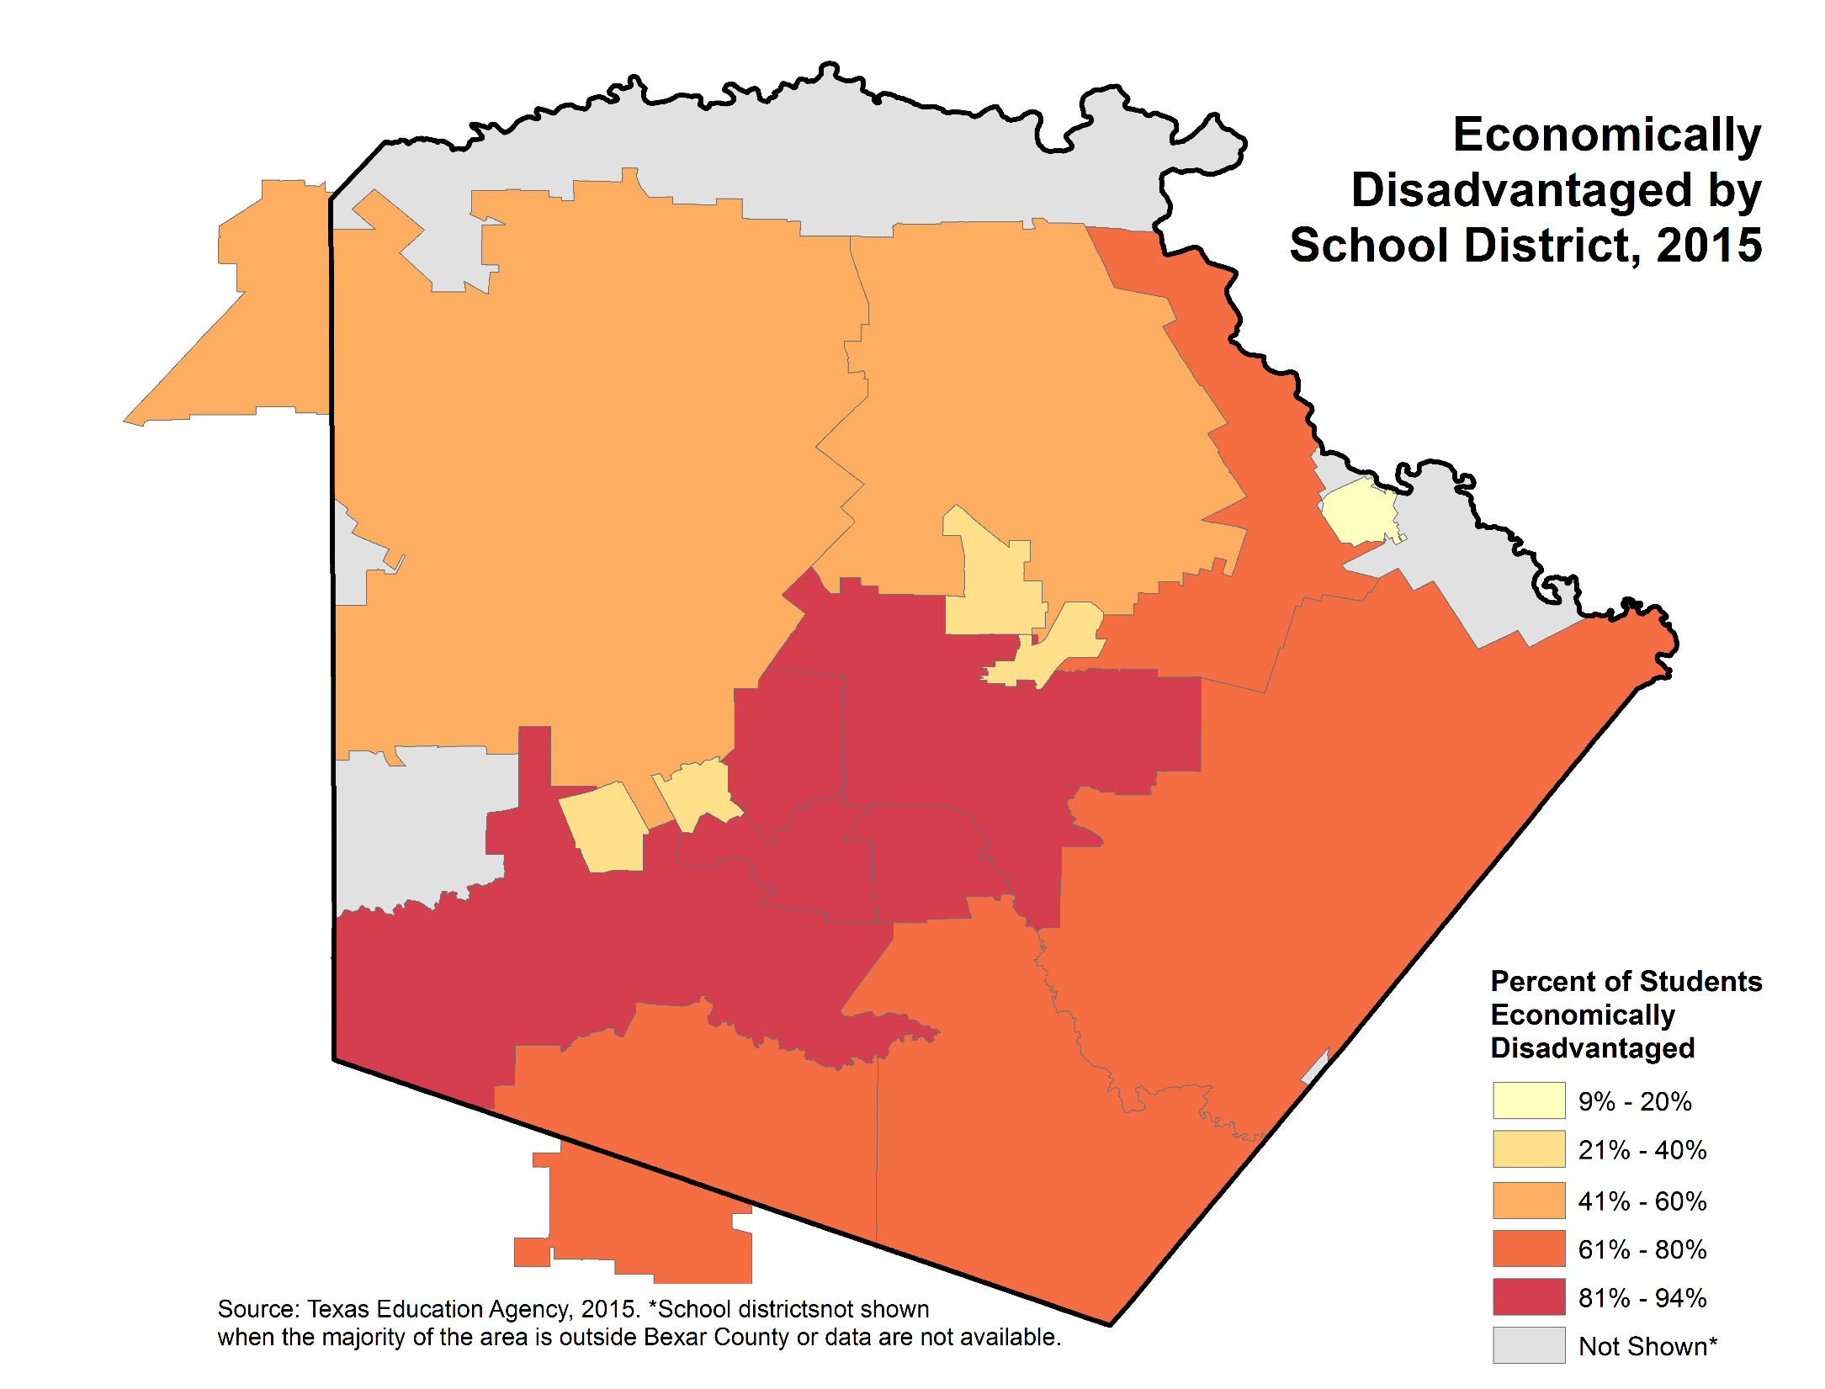
But many kids vulnerable
Still many kids economically disadvantaged
eligible for free/reduced meals; generally means below 185% of Federal Poverty Level
For 2016, 185% FPL is about $45,000 a year in household income
Equates to two adults working full-time at $10.80 per hour
Between 4 in 10 and 6 in 10 even on northside
Source: Texas Education Agency, 2015. *School districts not shown
when majority of the area is outside Bexar County or data are not available.

Slide 12
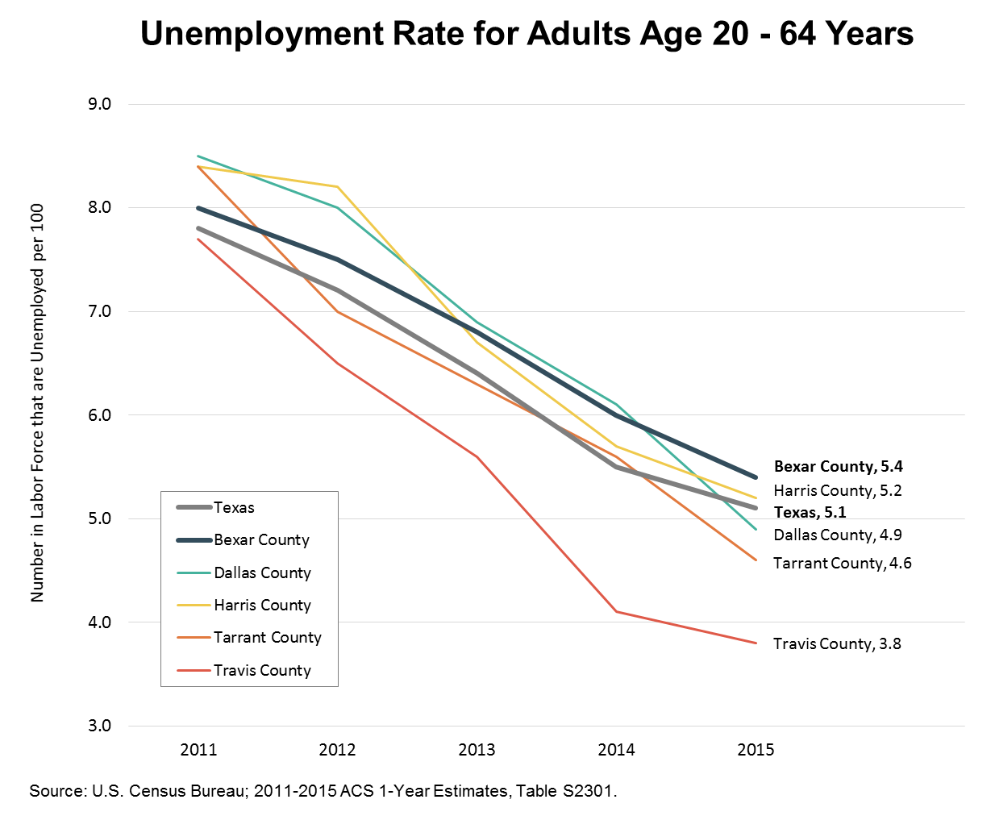
Unemployment declining
Texas and Bexar Co. recovering from recession
Excluded from this figure are people not seeking work, including:
Can’t afford child care
Lack of marketable skills
Criminal background
Depression, PTSD, substance abuse
About 35% of Bexar Co age 16 and older are not in labor force; 48% of those in poverty
Notes:
Unemployment - Comparison

Slide 13
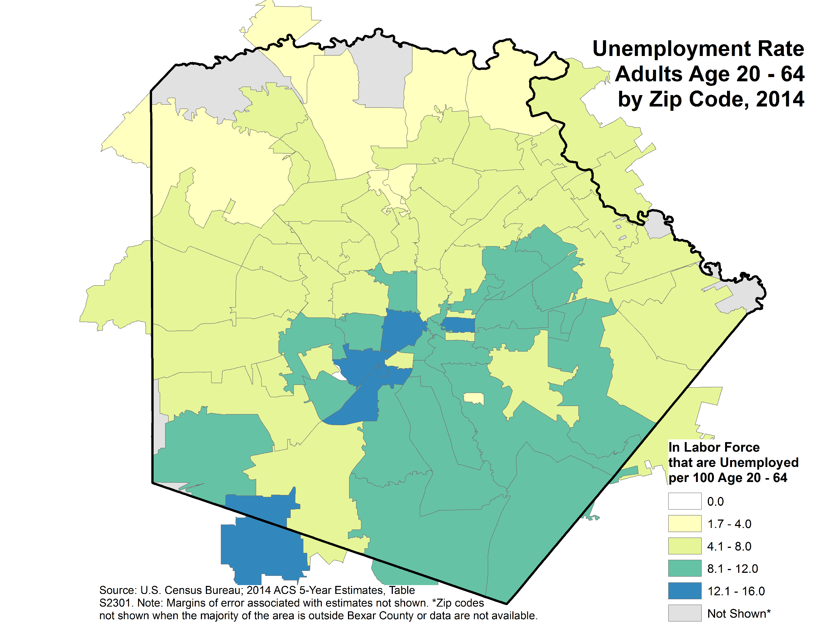
Unemployment also concentrated
Highest unemployment (12.1 to 16.0) on near eastside, near westside, southside along I-35
Lowest north of 1604
Notes:
Unemployment in Bexar County

Slide 14
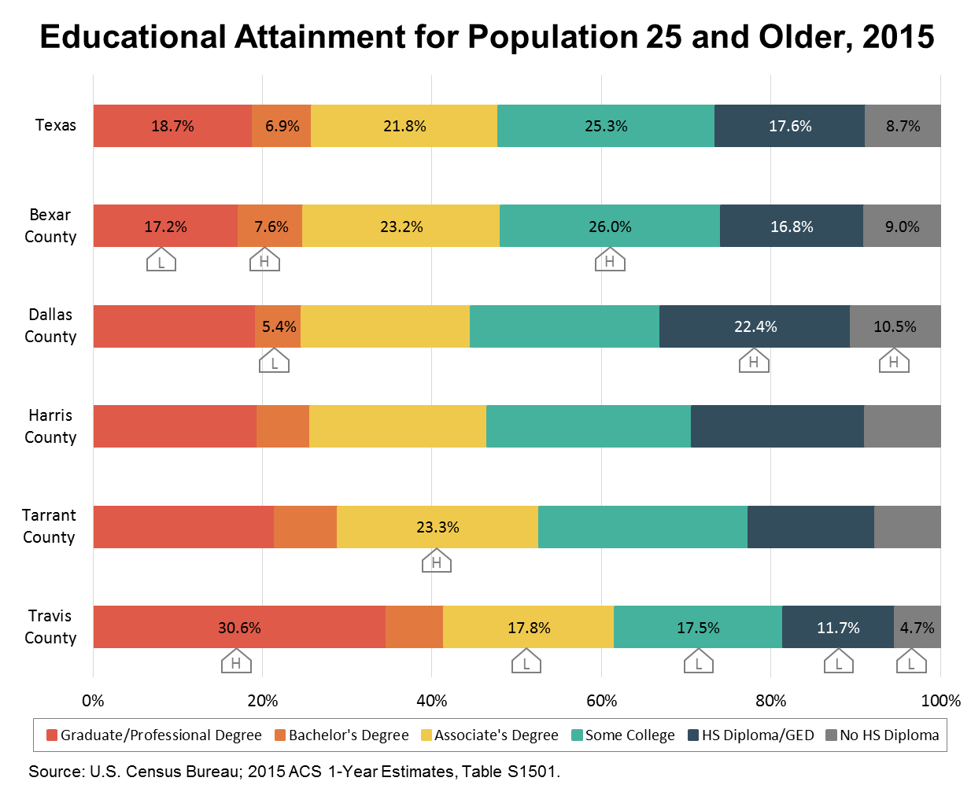
Bexar lags in educational attainment
“L” means lowest proportion among comparison counties and Texas
Percent with graduate/professional degree
“H” means highest proportion among comparison counties and Texas
Percent with Bachelor’s degree
Percent with some college
Almost one in 10 didn’t finish high school
Notes:
Educational Attainment - Comparison

Slide 15
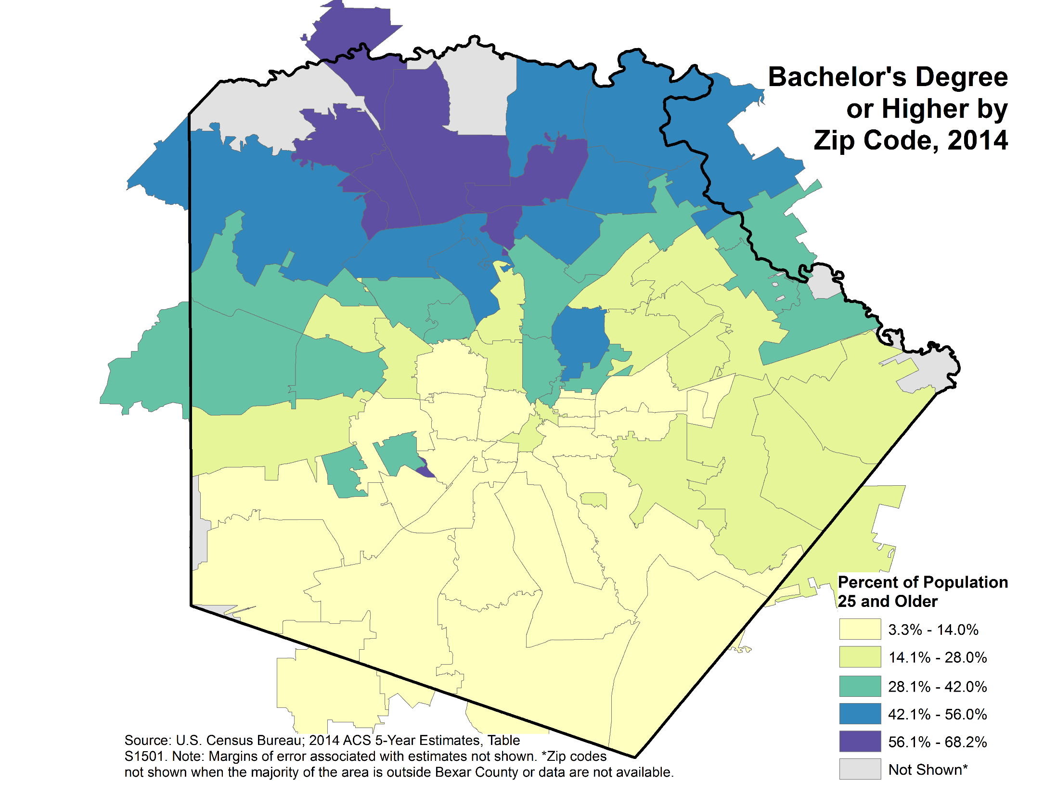
College degrees are concentrated
Highest proportion (56% to 68%) of adults 25 and older having bachelor’s or higher is far northside
Proportion is 14% or lower across almost the entire southern half of the county
Notes:
Educational Attainment in Bexar County

Slide 16
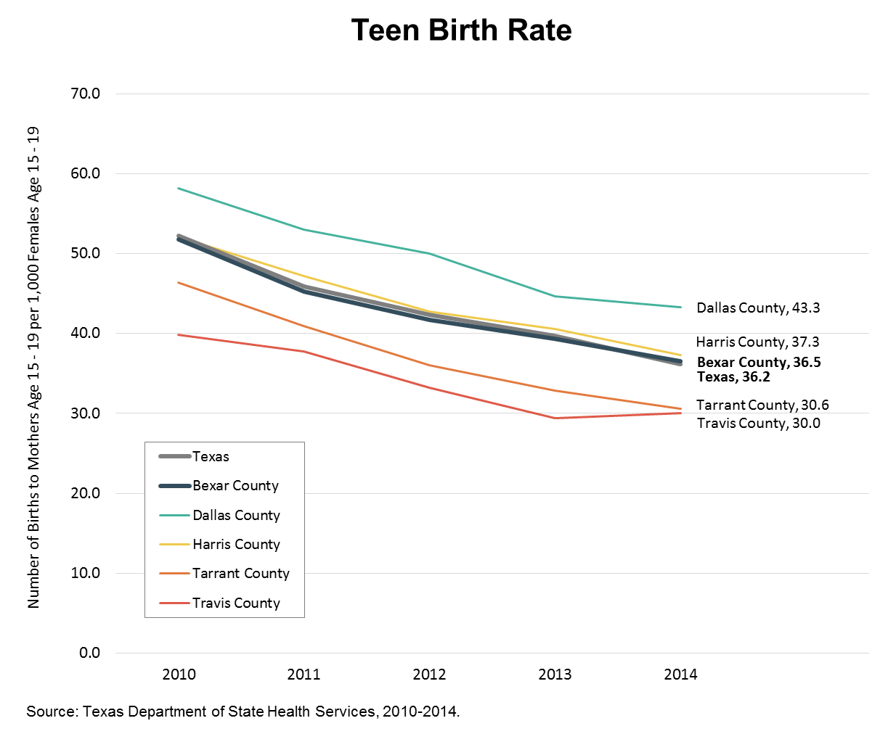
Many children are born to teens
Rate of births among teenagers declining across the country, including Texas and Bexar Co.
Bexar and Texas still much higher than national rate of 24.2 per 1,000 girls age 15-19 *
*Source: Martin, J.A., Hamilton, B.E., & Ventura, S. J. (2015). Births: Final Data for 2014. Hyattsville, MD: National Center for Health Statistics.
Notes:
Teen Birth Rate - Comparison

Slide 17
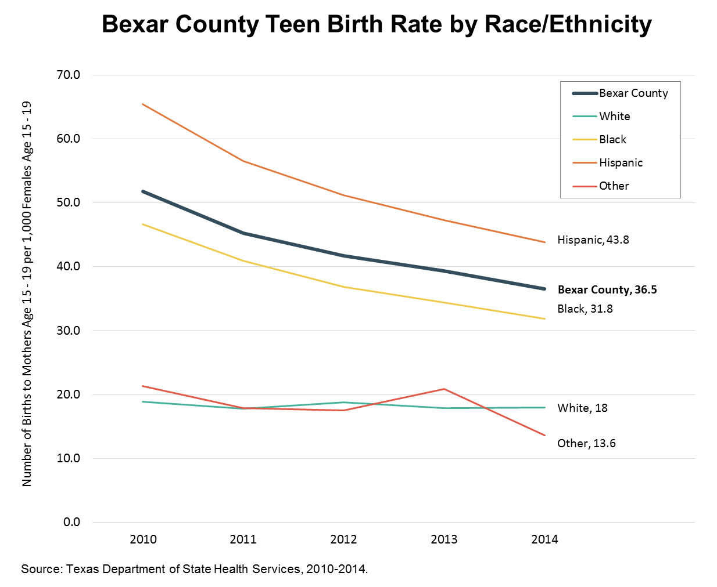
High rate not just result of Bexar demographics
Greatest declines are among Hispanic and African-American girls
Bexar Co. birthrate to:
Hispanic teens is 43.8 vs. 38.0 for U.S. Hispanics *
African-American teens is 31.8 vs. 34.9 for U.S. African-Americans *
White teens is 18.0 vs. 17.3 for U.S. Whites *
*Source: Martin, J.A., Hamilton, B.E., & Ventura, S. J. (2015). Births: Final Data for 2014. Hyattsville, MD: National Center for Health Statistics.
Notes:
Teen Birth Rate in Bexar County

Slide 18
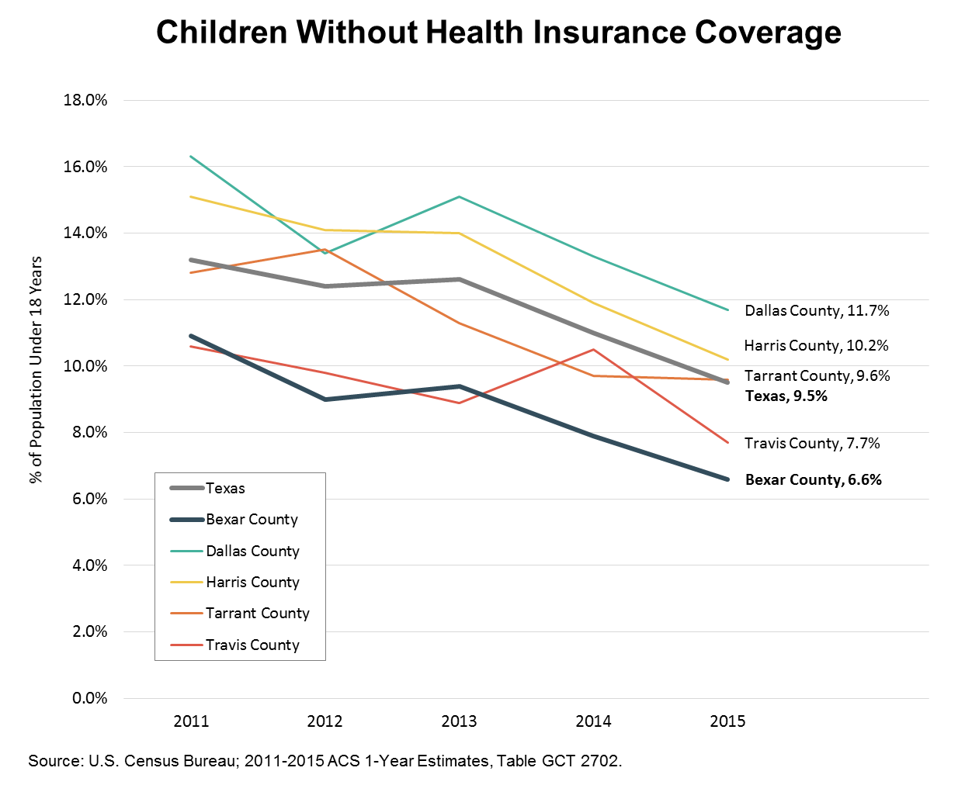
Decline in uninsured
Data not available specifically for age birth to 8
Bexar Co. kids less likely to be uninsured than in comparison counties and Texas
Bexar rate also had steepest decline since 2011 – 39% decrease vs. 28% drop in Texas, 25% drop in Tarrant
Notes:
Children Without Insurance Coverage - Comparison

Slide 19
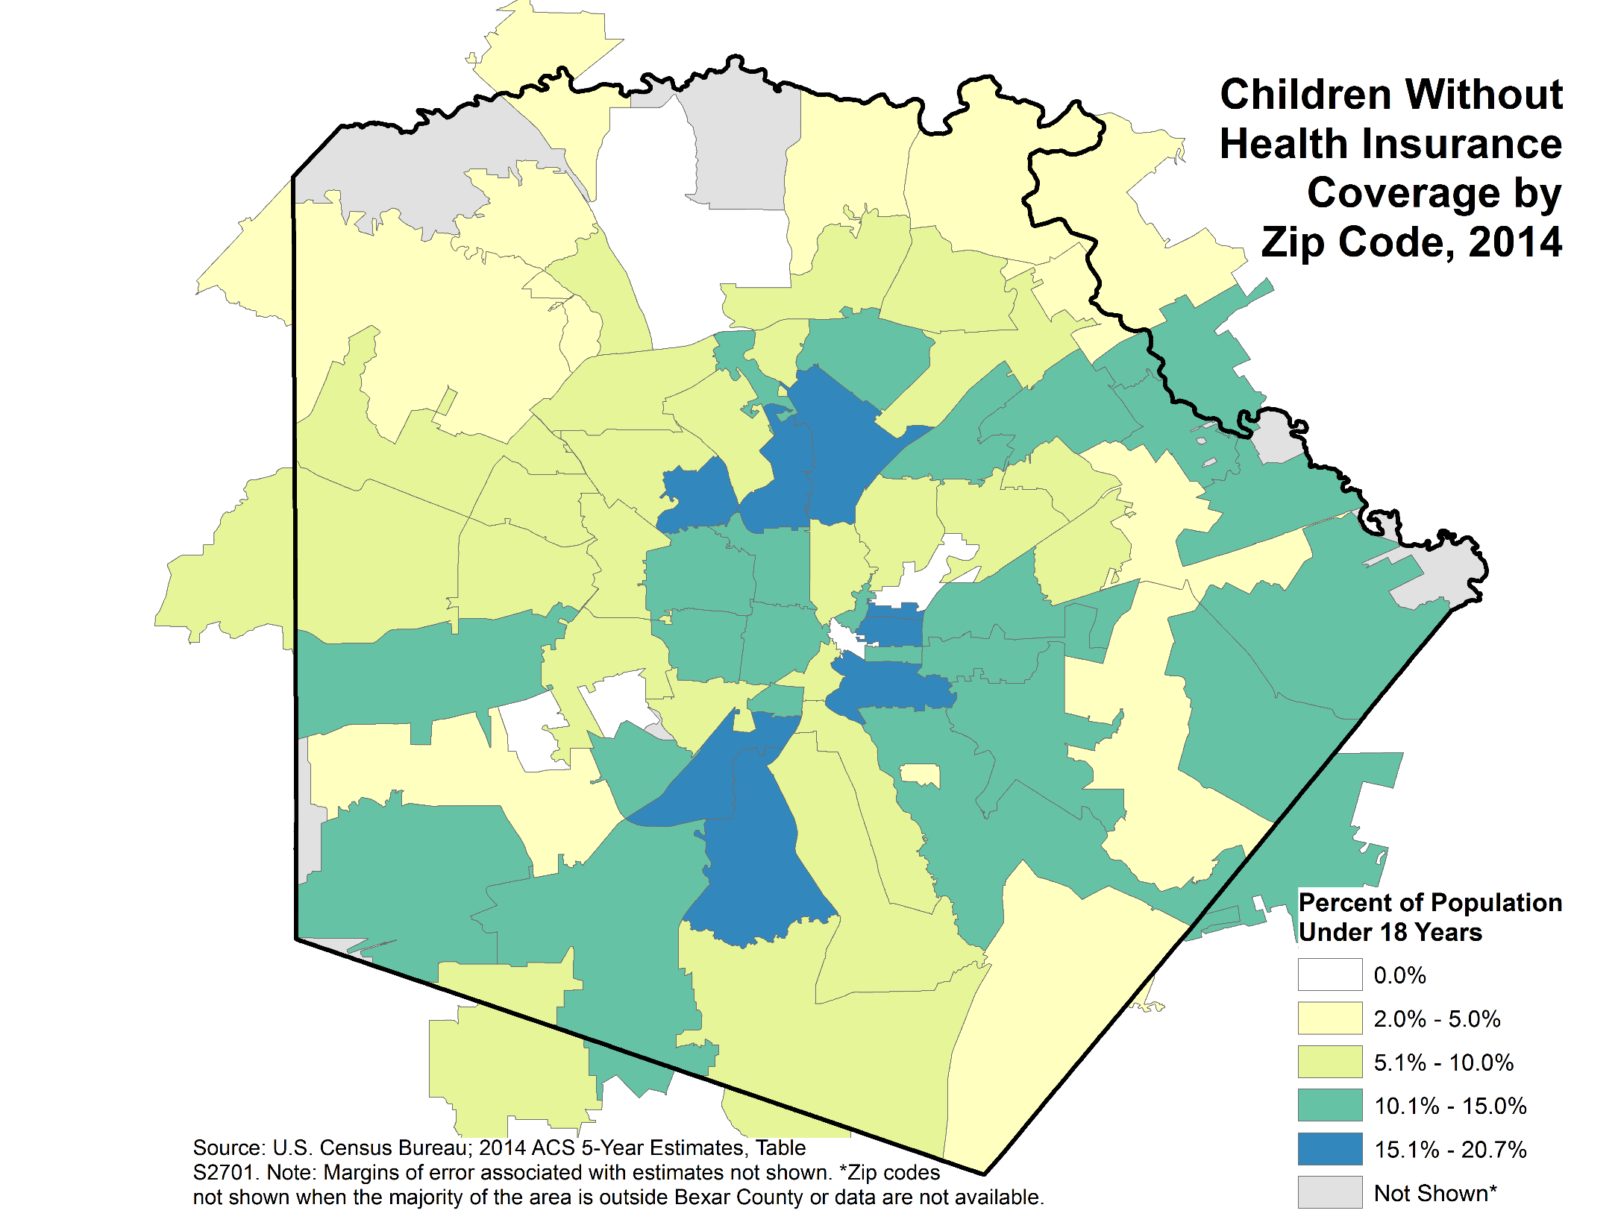
But uninsured kids are in all areas of county
Highest rates of uninsured kids (15%-21%) on:
near eastside,
southside along I-35,
northside (78216, 78213),
Med Center area (78229)
Notes:
Children Without Insurance Coverage in Bexar County

Slide 20
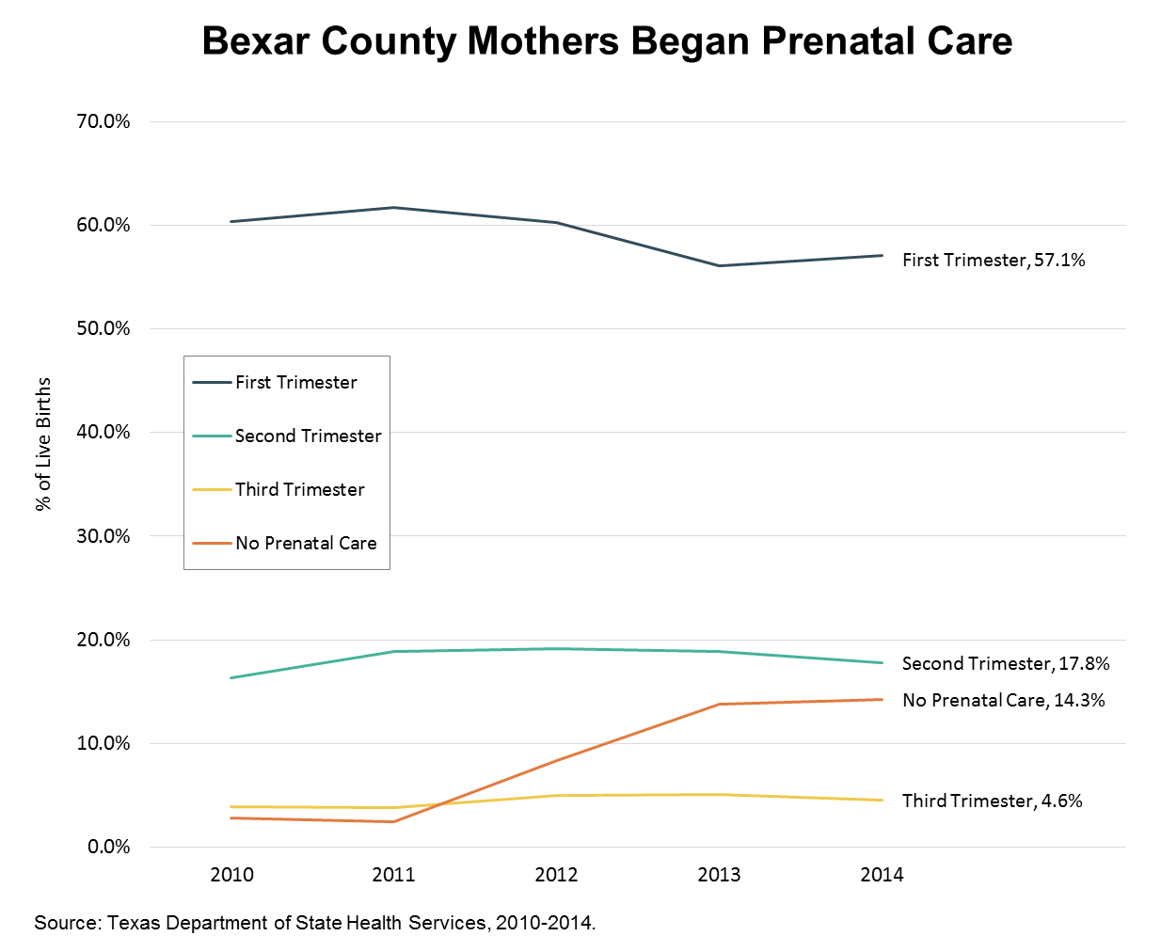
Losing ground on prenatal care
Percent with no prenatal care jumped from 2.8% in 2010 to 14.3% in 2014
Only 57% of births follow prenatal care beginning in first trimester
This metric doesn’t capture the full scope of “early and adequate” primary care
Notes:
Prenatal Care in Bexar County

Slide 21
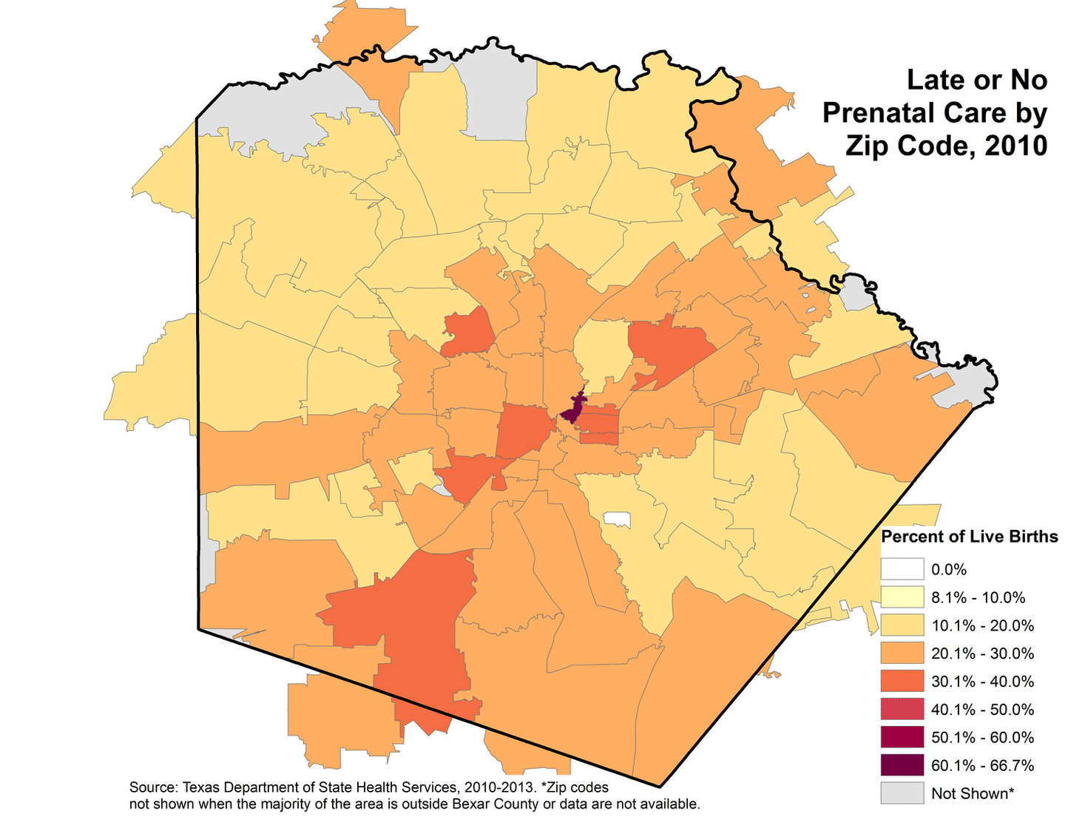
Many children born after late or no prenatal care
Substantial proportion of women getting late or no prenatal care in every area of county
Steep increase between 2010 and 2014 in births following late or no prenatal care
Map is animated time series
Notes:
Prenatal Care in Bexar County 2

Slide 22
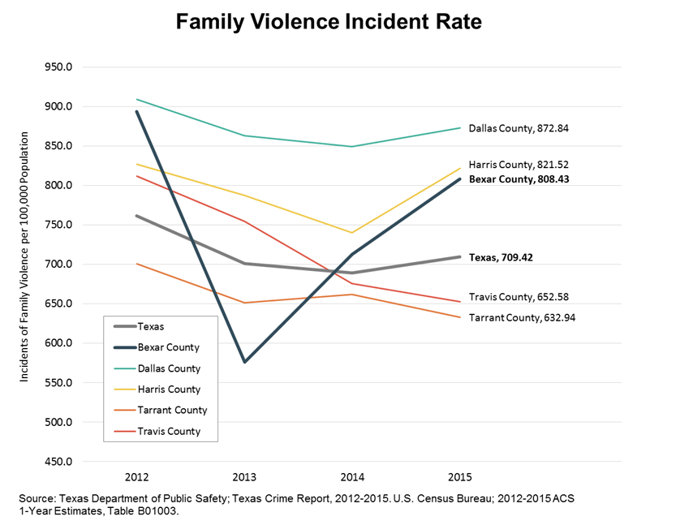
Family/dating violence
Rate is number of incidents per 100,000 pop; one incident may involve one or many victims
Rate is “volatile” – bounces around – but higher than Texas. Reason for 2013-2014 dip not yet known.
In Texas in 2015, victim was most commonly the offender’s:
wife or common-law wife (28% of victims),
other female family member (22%),
mother/stepmother (6%),
daughter/stepdaughter (4%) , or
sister/stepsister (4%)
Notes:
Family Violence - Comparison

Slide 23
How are our kids doing?

Slide 24
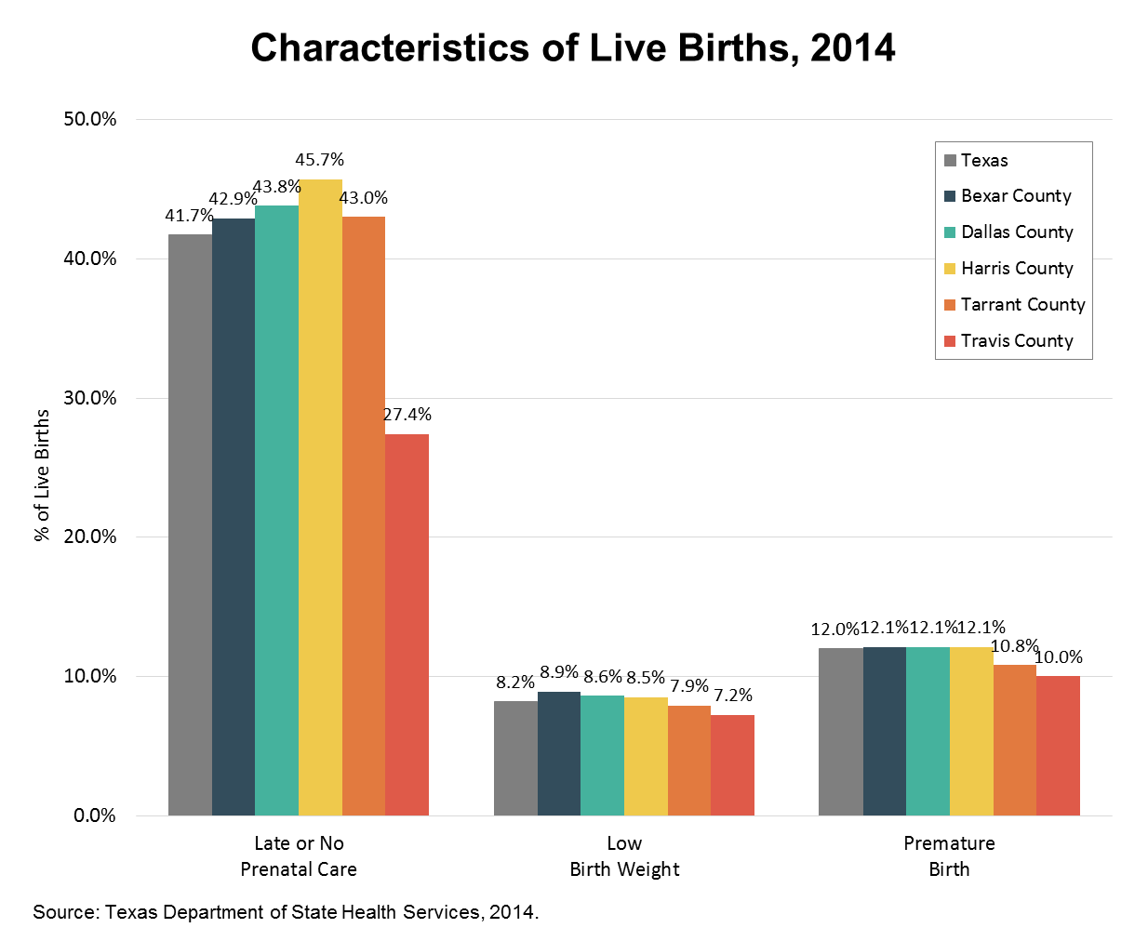
Many children start life already behind
Bexar Co. same or worse than Texas on all measures:
43% of Bexar Co. births follow late or no prenatal care
9% of babies born with low birthweight
12% are premature
Notes:
Characteristics of Live Births - Comparison

Slide 25
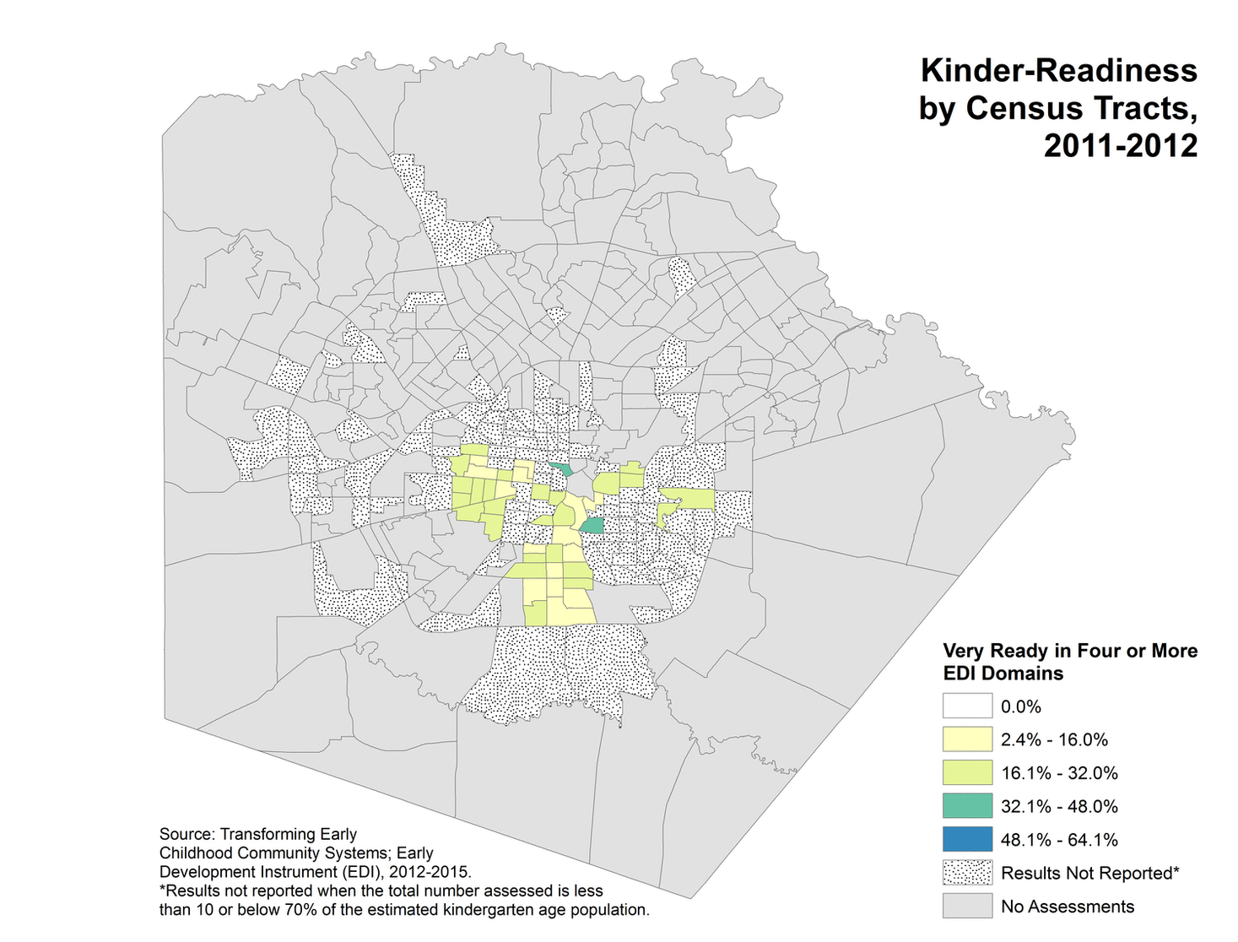
Few children are “very ready” for kindergarten
As assessed by EDI kinder-readiness tool
Dataset is incomplete but improving as more districts participate
Understanding trend is complicated by mobility
Many more EDI maps and tables are available at
http://readykidsa.com/client-resources-referrals/early-development-instrument-edi/
Map is animated time series
Notes:
Kinder Readiness – EDI Very Ready in Bexar County

Slide 26
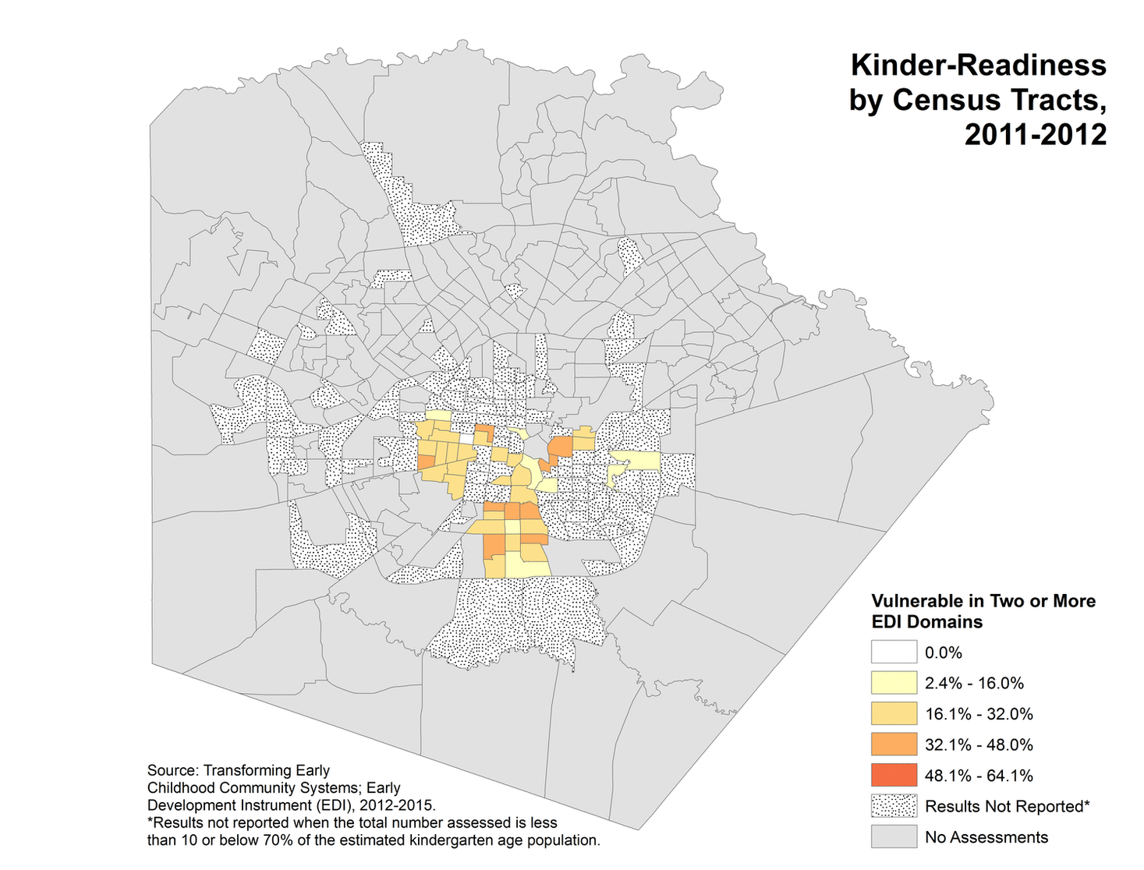
Many children are “vulnerable”
Score in lowest 10th percentile of national sample in two or more domains
Dotted gray areas are census tracts with too few assessments to be representative of child population, or so few that privacy is an issue
Many more EDI maps and tables are available at
http://readykidsa.com/client-resources-referrals/early-development-instrument-edi/
Map is animated time series
Notes:
Kinder Readiness – EDI Vulnerable in Bexar County

Slide 27
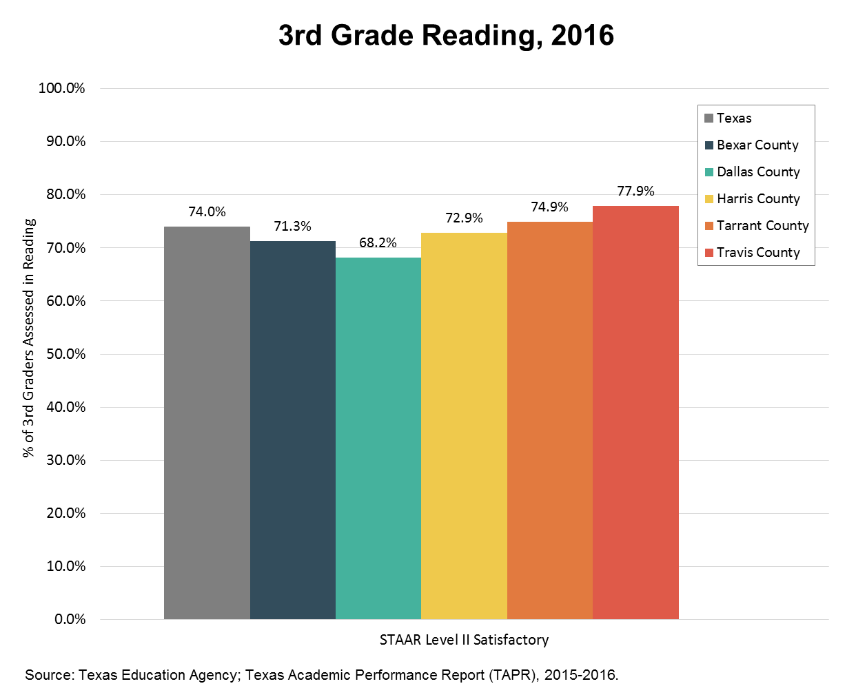
Many kids lag in reading
Only Dallas Co (68%) has lower percent of kids passing STAAR reading than Bexar Co. (71%)
STAAR not without issues, but best metric we currently have
Notes:
3rd Grade Reading - Comparison

Slide 28
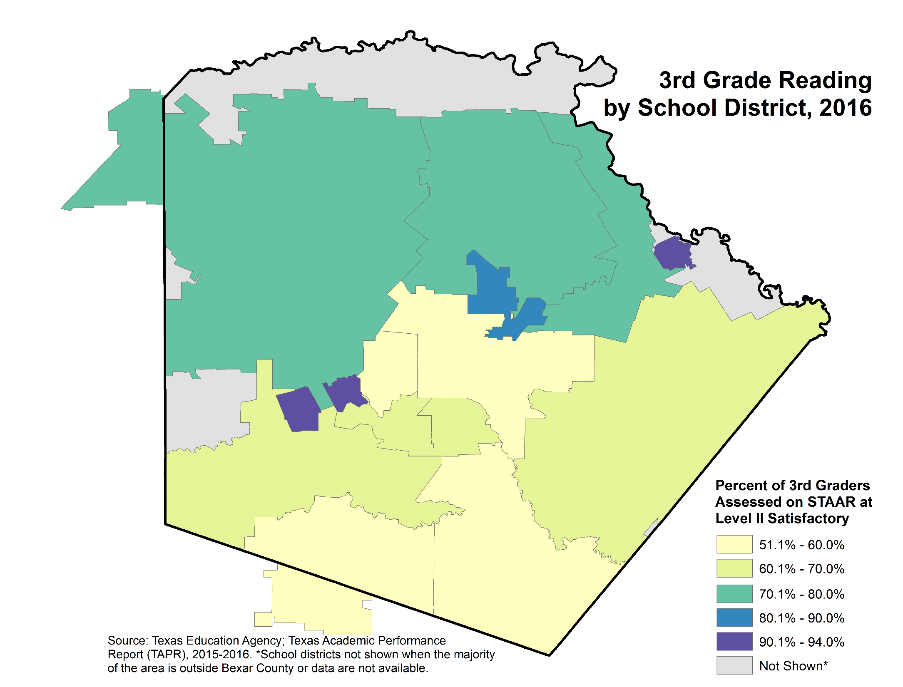
Third-grade reading ability varies across county
Highest percent of kids passing is in military districts (Lackland, Randolph, Fort Sam) and Alamo Heights ISD
Lowest percent is in Edgewood, San Antonio, Southside, Somerset ISDs
Notes:
3rd Grade Reading in Bexar County

Slide 29
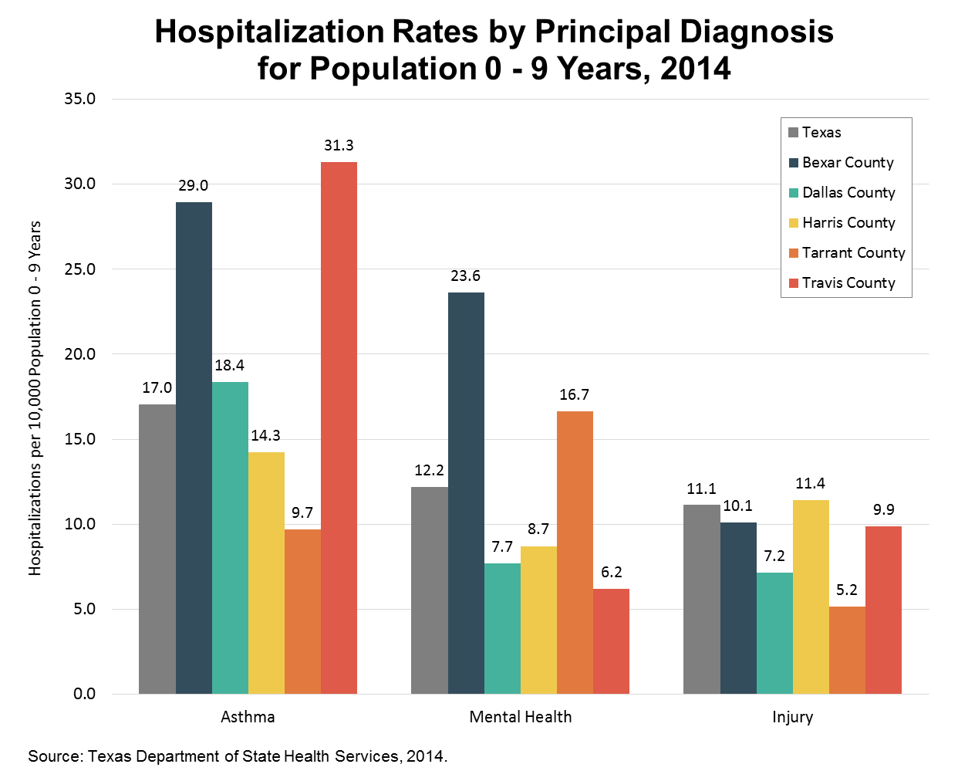
Kids hospitalized with asthma, mental illness, injury
Bexar hospitalization rate for:
asthma is 29.0 per 10,000 kids age birth to nine, 70% higher than state rate
mental illness is 23.6, almost double the state rate
injury is 10.1, slightly lower than state rate
Notes:
Hospitalization Rates for Population 0-9 by Cause - Comparison

Slide 30
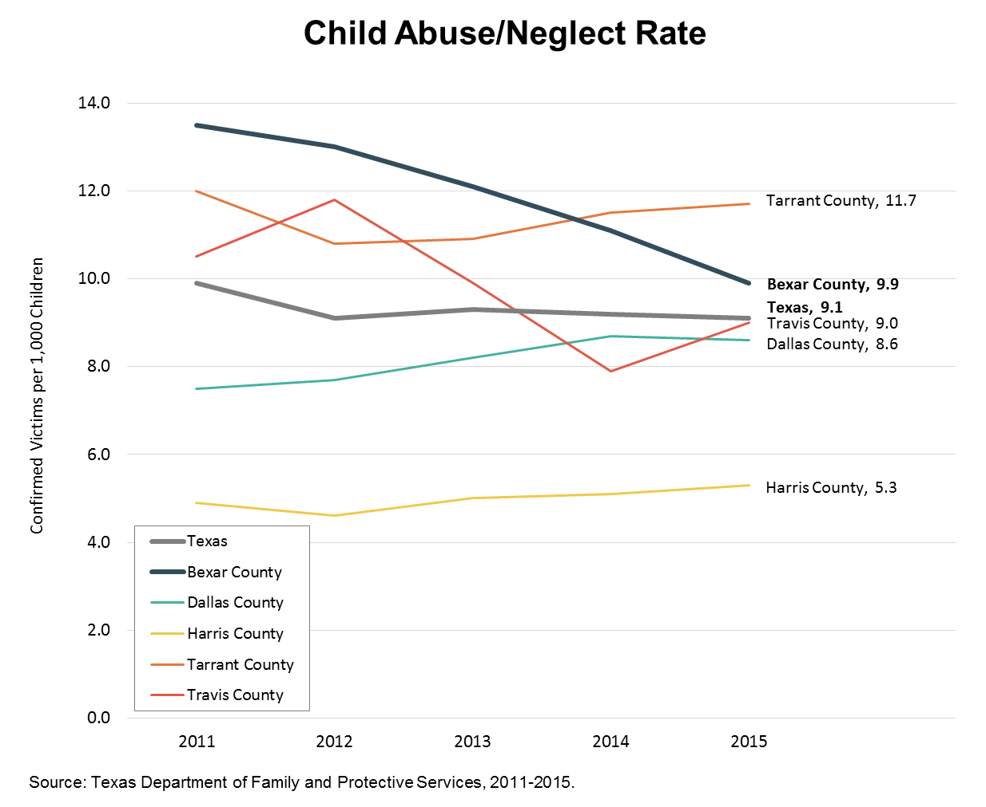
What’s going on with abuse/neglect?
Rate has stayed roughly flat in all comparison counties and Texas since 2011
Bexar has dropped 27%, from 13.5 in 2011 to 9.9 in 2015
This metric alone may not accurately portray Bexar County’s burden of child abuse and neglect
Notes:
Child Abuse and Neglect - Comparison

Slide 31
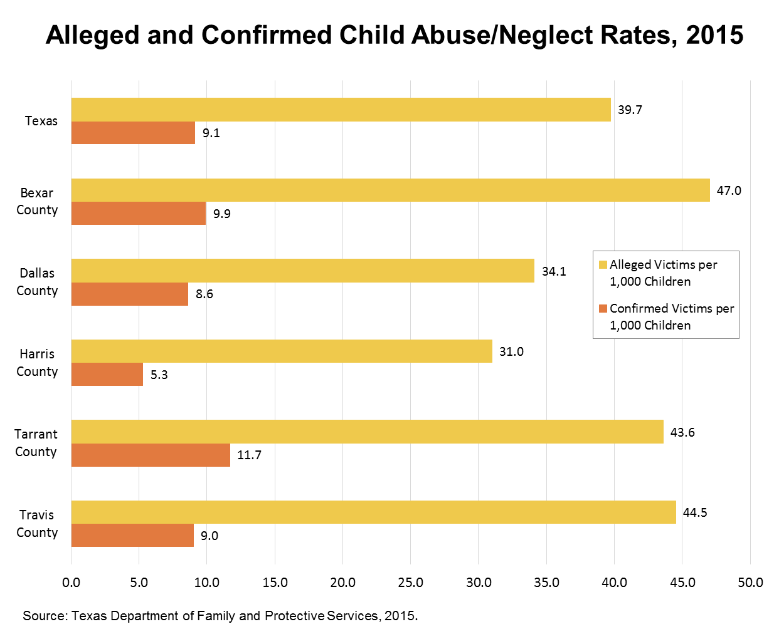
Big differences across state in alleged victims
Bexar alleged victims totaled 47.0 per 1,000 children vs. 39.7 in Texas
Notes:
Child Abuse and Neglect – Case Movement 2

Slide 32
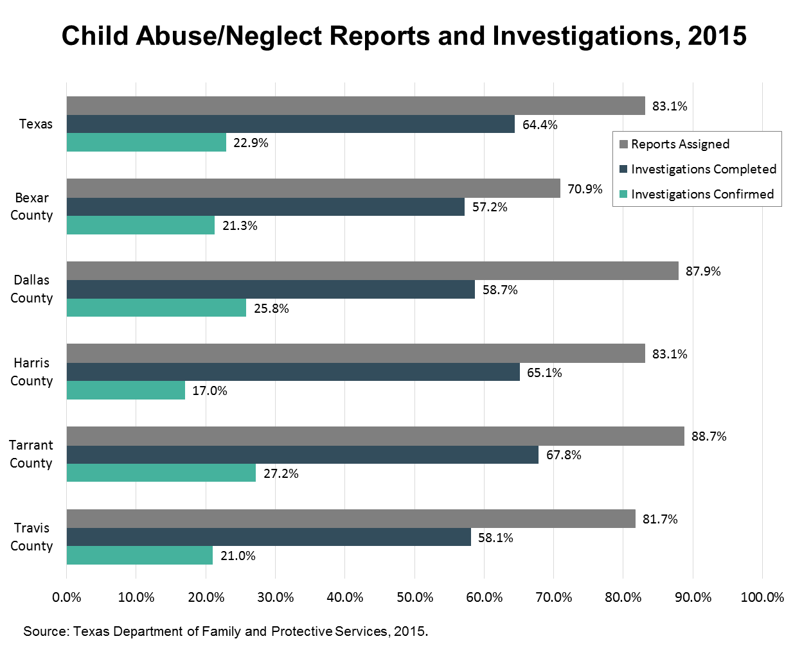
Big differences in investigation rates
Only 71% of Bexar Co. reports are assigned for investigation vs. 83% in Texas
Only 57% of those investigations are completed, vs. 64% in Texas
But percent of completed investigations confirmed are similar (Bexar 21%, Texas 23%)
Notes:
Child Abuse and Neglect – Case Movement 1

Slide 33
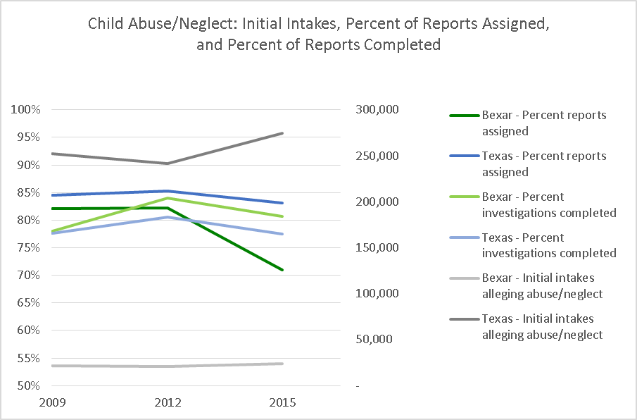
Investigation rate has dropped
Bexar percent of reports assigned to investigation drops sharply from 2012 (82%) to 2015 (71%)
Likely effect on rate of confirmed victims
Source: US Texas Department of Family and Protective Services, 2009,2012, 2015

Slide 34
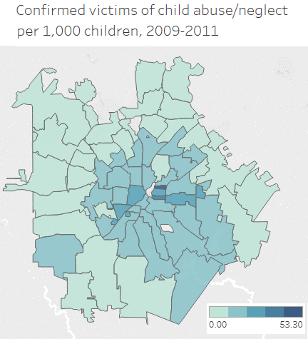
Child abuse/neglect occurs across the county
Rate by zip code changes year-to-year, but highest rates generally in near westside, near eastside
Significant rate in northside as well
No neighborhood is free of child abuse and neglect
Map is animated time series
Source: San Antonio Metropolitan Health District Health Profiles 2009-2013

Slide 35
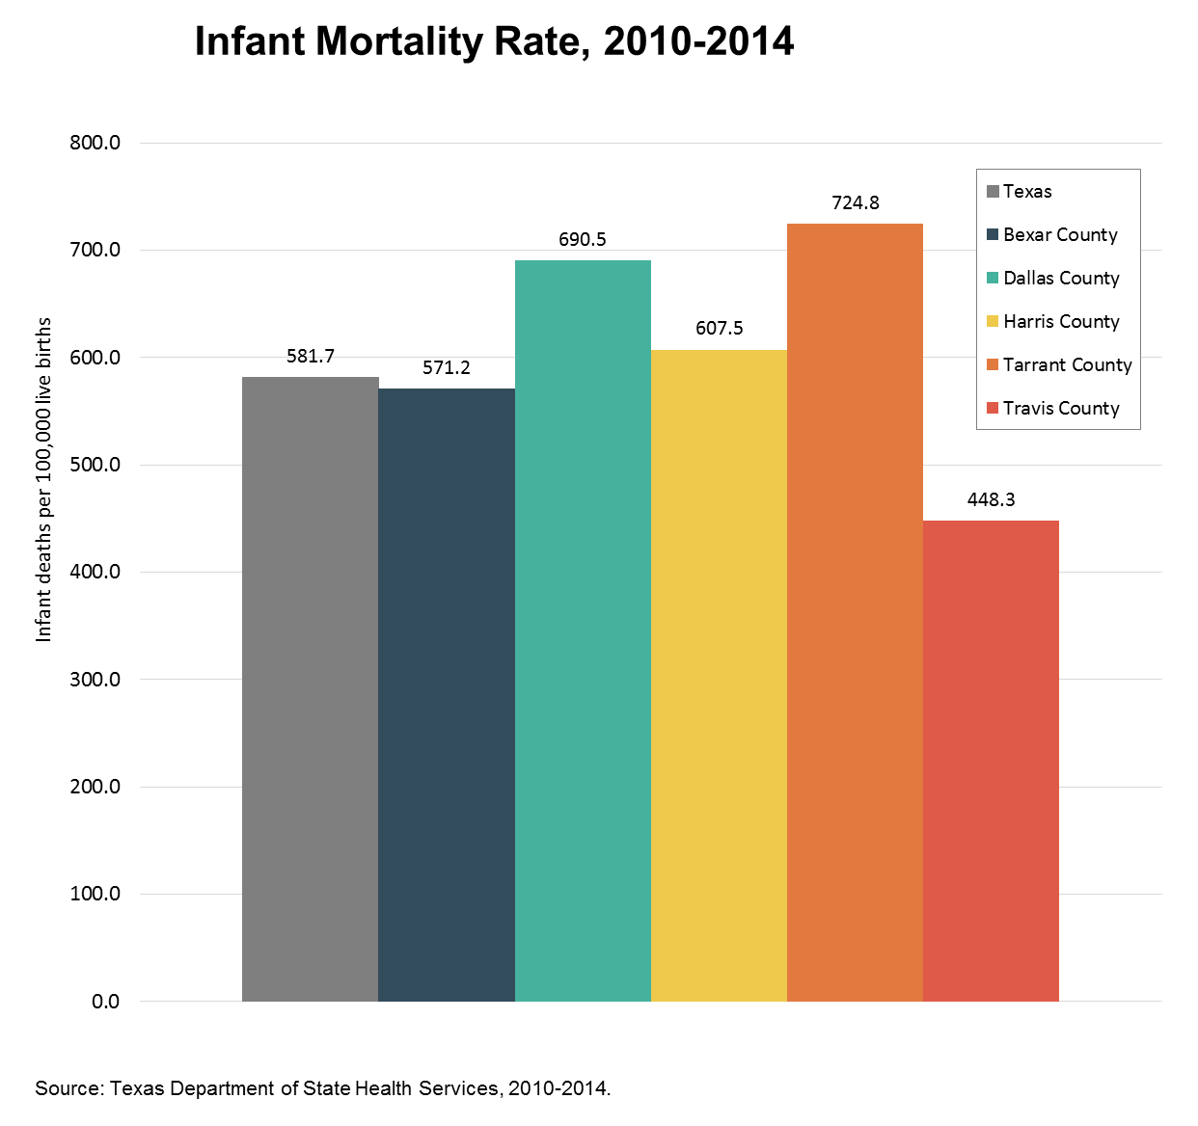
Lower infant mortality
Deaths per 100,000 live births lower than Texas and most comparison counties
Notes:
Infant Mortality in Bexar County

Slide 36
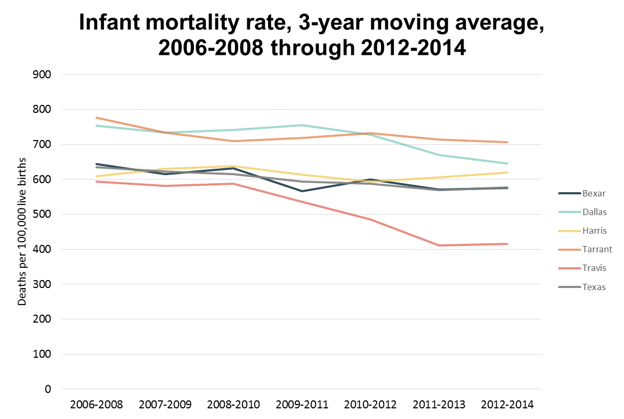
But little improvement over time
Bexar infant mortality rate has remained fairly flat – 9% decrease from 2000-2002, compared to Travis decrease of 24%
Tracking alongside Texas rate
Source: Texas Department of State Health Services, 2012-2014

Slide 37
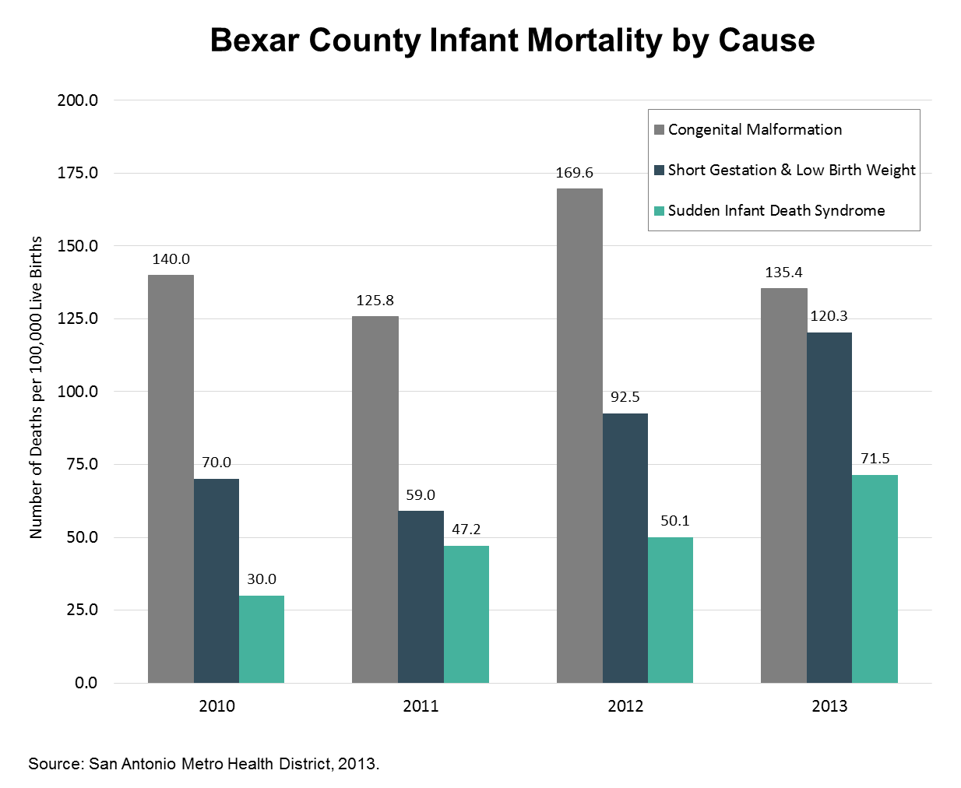
Causes changing
Steady increase in infant mortality due to
prematurity (short gestation) and low birth weight
SIDS
Notes:
Infant Mortality in Bexar County

Slide 38
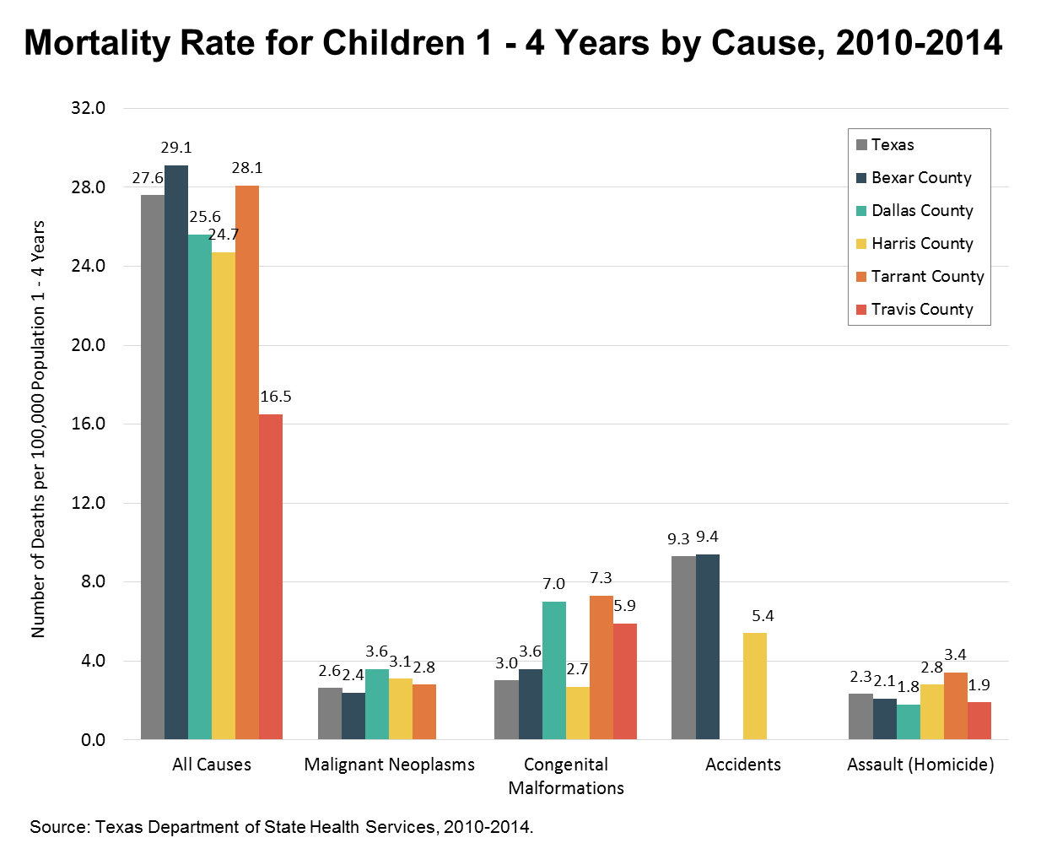
Accidents major cause of toddler deaths
Bexar death rate among 1-to 4-year-olds higher than state and comparison counties
Accidents are major cause; rate higher than state
Homicide kills young children at nearly as high a rate as cancer
Notes:
Child Mortality 1-4 by Cause– Comparison

Slide 39
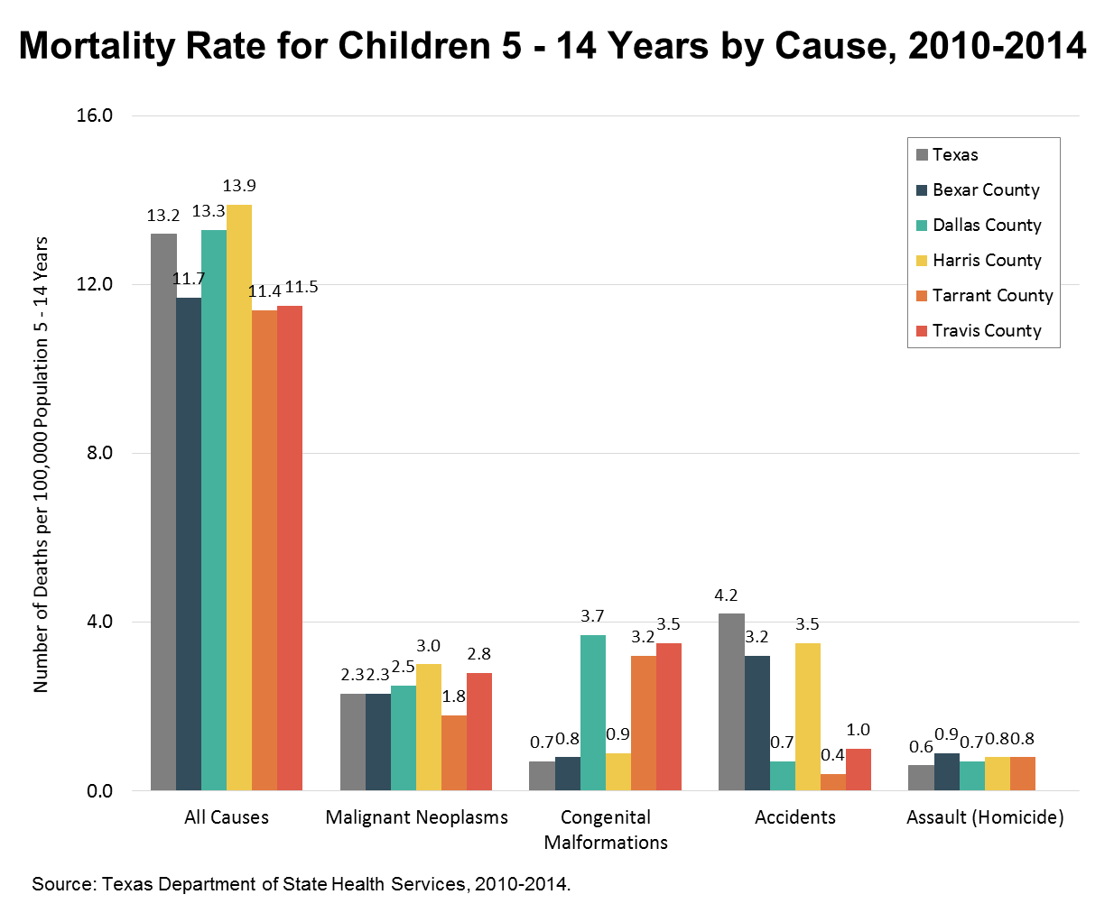
Older children do better relative to Texas
Bexar total mortality rate for older kids lower than Texas and some comparison counties
Delayed consequences of birth defects and accidents are major causes of death
Homicide rate is low compared to other causes, but consistently as high or higher than state and comparison counties
Notes:
Child Mortality 5-14 by Cause – Comparison

Slide 40
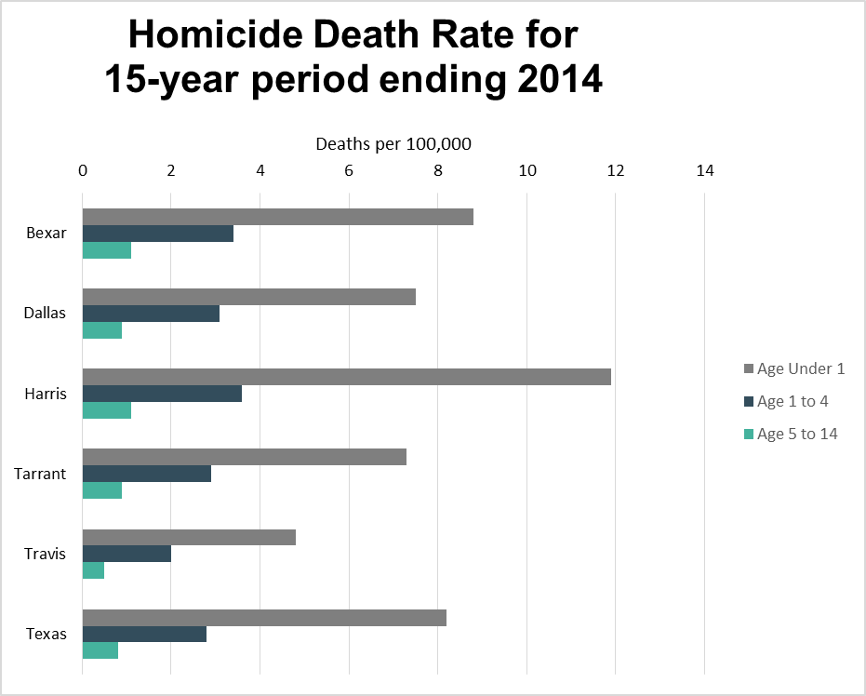
Child deaths by homicide
Rate of child death from homicide higher in all age groups than Texas and every comparison county but Harris
Not the leading cause of death in any group, but socially important and a trustworthy metric
Time period is 2000-2014 to reduce instability of rate
Source: Texas Department of State Health Services, 1999-2014

Slide 41
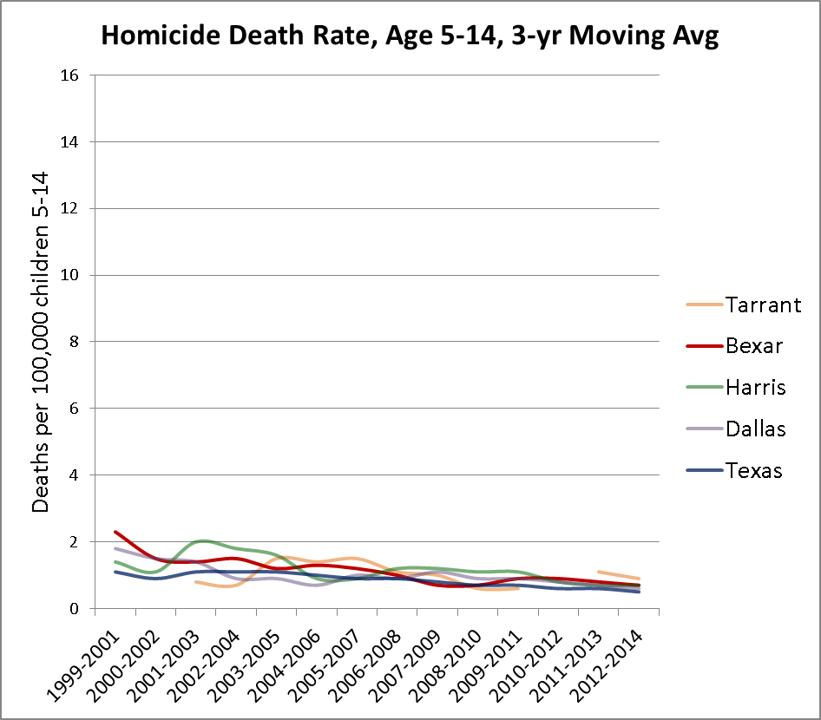
Older child deaths by homicide leveling out
Bexar Co. rate is still a bit higher than Texas
Even using three-year moving average, rate is still very volatile
Source: Texas Department of State Health Services, 1999-2014

Slide 42
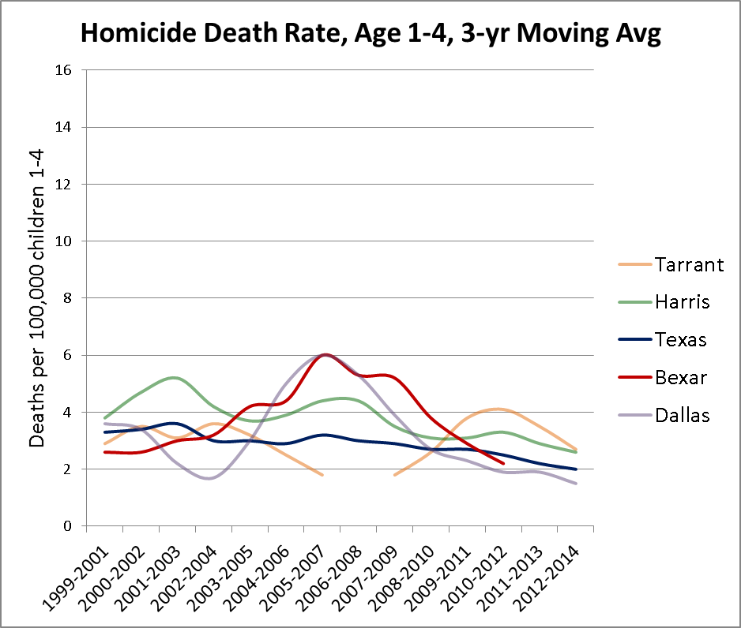
Younger child deaths by homicide declining
Decline follows sharp spike
Bexar Co. rate is now similar to Texas
Even using three-year moving average, rate is still very volatile
Source: Texas Department of State Health Services, 1999-2014

Slide 43
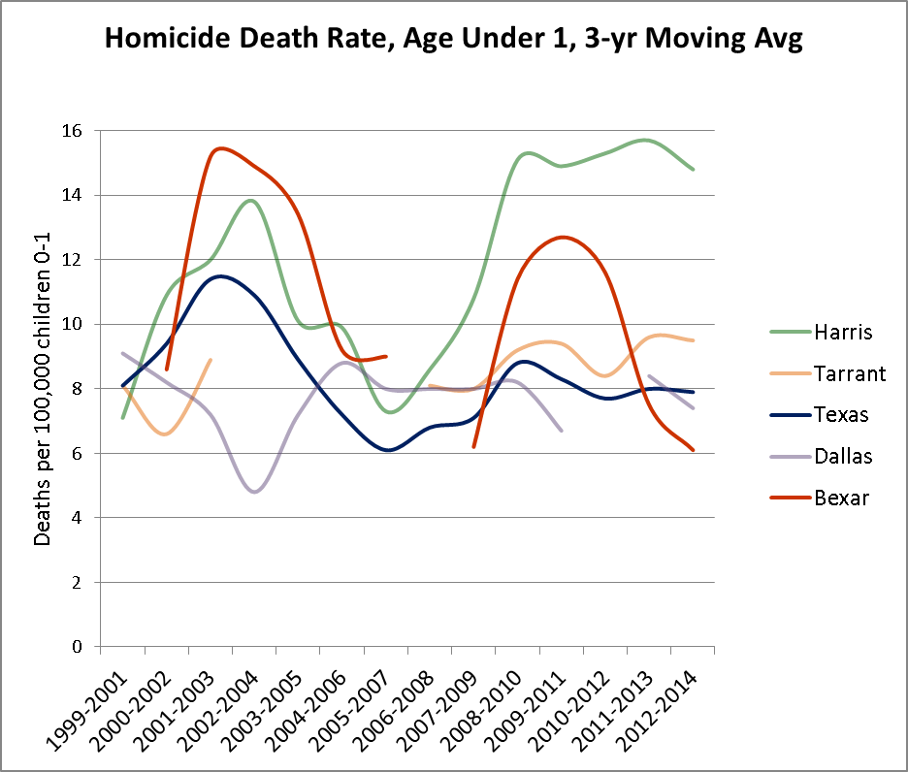
Infant deaths declining after spike
Even using three-year moving average, rate is still very volatile
Bexar Co. rate appears to have peaked during recessions
Source: Texas Department of State Health Services, 1999-2014

Slide 44
What are the long-term consequences of childhood stress?

Slide 45

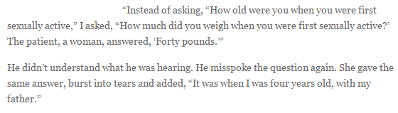
Adverse Childhood Experience (ACE)
Physician in a Kaiser Permanente obesity program saw a 50% dropout rate among patients who were losing weight – didn’t make sense
Did interviews with individual patients and at one point accidentally asked a question wrong:
Dr. Vincent Felitti
https://acestoohigh.com/2012/10/03/the-adverse-childhood-experiences-study-the-largest-most-important-public-health-study-you-never-heard-of-began-in-an-obesity-clinic/

Slide 46
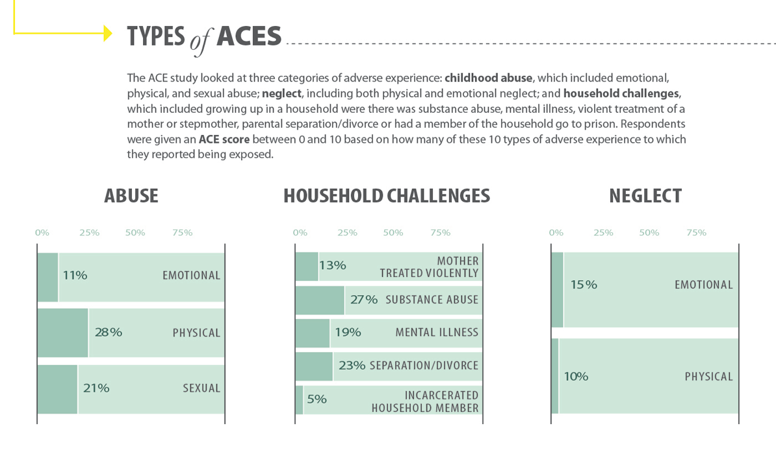
Source: Centers for Disease Control and Prevention, 2016. (https://www.cdc.gov/violenceprevention/acestudy/index.html)

Slide 47
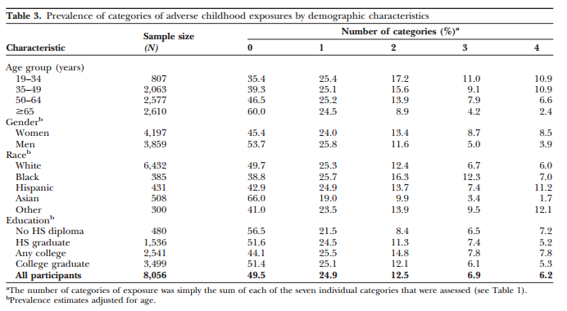
http://www.iowaaces360.org/uploads/1/0/9/2/10925571/relationship_of_childhood_abuse_and..._1998.pdf

Slide 48
Turns out ACEs affect you later on… a lot.
Study population was generally middle-class, middle-aged, college-educated HMO (health maintenance organization, an insurance plan) members – not a high-risk group
Those who reported having experienced just four or more of 10 categories of ACE were:
  four to 12 times as likely to have struggled with alcoholism, substance abuse, depression, and suicide attempts
  two to four times as likely to smoke, to have had 50 or more sexual intercourse partners, and to have had a sexually transmitted disease
  1.4 or more times as likely to be physically inactive and severely obese
http://www.iowaaces360.org/uploads/1/0/9/2/10925571/relationship_of_childhood_abuse_and..._1998.pdf

Slide 49

Trustworthy.
Neutral.
Timely.
How can we help you?
Laura.C.McKieran@uth.tmc.edu
CINow.info
210.276.9007
http://cinow.info/newsletter-signup/

